Slide 1

Pennant Technologies Private Limited
JDBC Prepared Statements

Slide 4
Introduction
Once a connection is obtained we can interact with the database. The JDBC Statement, CallableStatement, and PreparedStatement interfaces define the methods and properties that enable you to send SQL or PL/SQL commands and receive data from your database.
They also define methods that help bridge data type differences between Java and SQL data types used in a database.
The following table provides a summary of each interface's purpose to decide on the interface to use.

Slide 5
Interfaces | Recommended Use
Statement | Use this for general-purpose access to your database. Useful when you are using static SQL statements at runtime. The Statement interface cannot accept parameters.
PreparedStatement | Use this when you plan to use the SQL statements many times. The PreparedStatement interface accepts input parameters at runtime.
CallableStatement | Use this when you want to access the database stored procedures. The CallableStatement interface can also accept runtime input parameters.

Slide 6
The Statement Objects
Creating Statement Object
Before you can use a Statement object to execute a SQL statement, you need to create one using the Connection object's createStatement( ) method, as in the following example −
Statement stmt = null;
try {
stmt = conn.createStatement( );
. . .
}
catch (SQLException e) {
. . .
}
finally {
. . .
}

Slide 7
Once you've created a Statement object, you can then use it to execute an SQL statement with one of its three execute methods.
boolean execute (String SQL): Returns a boolean value of true if a ResultSet object can be retrieved; otherwise, it returns false. Use this method to execute SQL DDL statements or when you need to use truly dynamic SQL.
int executeUpdate (String SQL) − Returns the number of rows affected by the execution of the SQL statement. Use this method to execute SQL statements for which you expect to get a number of rows affected - for example, an INSERT, UPDATE, or DELETE statement.
ResultSet executeQuery (String SQL) − Returns a ResultSet object. Use this method when you expect to get a result set, as you would with a SELECT statement.

Slide 8
Closing Statement Object
Just as you close a Connection object to save database resources, for the same reason you should also close the Statement object.
A simple call to the close() method will do the job. If you close the Connection object first, it will close the Statement object as well. However, you should always explicitly close the Statement object to ensure proper cleanup.
Statement stmt = null;
try {
stmt = conn.createStatement( );
. . .
}
catch (SQLException e) {
. . .
}
finally {
stmt.close();
}

Slide 9
PreparedStatement interface
The PreparedStatement interface is a subinterface of Statement. It is used to execute parameterized query.
Let's see the example of parameterized query:
String sql="insert into emp values(?,?,?)";
As you can see, we are passing parameter (?) for the values. Its value will be set by calling the setter methods of PreparedStatement.
Why use PreparedStatement?
Improves performance: The performance of the application will be faster if you use PreparedStatement interface because query is compiled only once.
How to get the instance of PreparedStatement?
The prepareStatement() method of Connection interface is used to return the object of PreparedStatement.
Syntax: public PreparedStatement prepareStatement(String query)throws SQLException{}

Slide 10
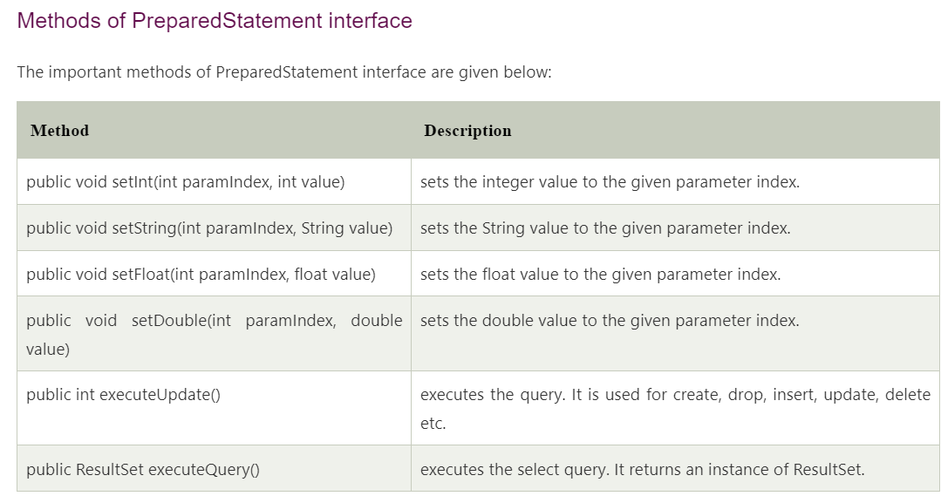

Slide 11
Example of PreparedStatement interface that inserts the record
First of all create table as given below: create table emp(id number(10),name varchar2(50));
Now insert records in this table by the code given below:
import java.sql.*;
class InsertPrepared{
public static void main(String args[]){
try{
Class.forName("oracle.jdbc.driver.OracleDriver");
Connection con=DriverManager.getConnection("jdbc:oracle:thin:@localhost:1521:xe","system","oracle");
PreparedStatement stmt=con.prepareStatement("insert into Emp values(?,?)");
stmt.setInt(1,101);//1 specifies the first parameter in the query
stmt.setString(2,"Ratan");
int i=stmt.executeUpdate();
System.out.println(i+" records inserted");
con.close();
}catch(Exception e){ System.out.println(e);} } }

Slide 12
Example of PreparedStatement interface that updates the record
PreparedStatement stmt=con.prepareStatement("update emp set name=? where id=?");
stmt.setString(1,"Sonoo");//1 specifies the first parameter in the query i.e. name
stmt.setInt(2,101);
int i=stmt.executeUpdate();
System.out.println(i+" records updated");
Example of PreparedStatement interface that deletes the record
PreparedStatement stmt=con.prepareStatement("delete from emp where id=?");
stmt.setInt(1,101);
int i=stmt.executeUpdate();
System.out.println(i+" records deleted");

Slide 13
The PreparedStatement Objects
The PreparedStatement interface extends the Statement interface, which gives you added functionality with a couple of advantages over a generic Statement object.
This statement gives you the flexibility of supplying arguments dynamically.
Creating PreparedStatement Object
PreparedStatement pstmt = null;
try {
String SQL = "Update Employees SET age = ? WHERE id = ?";
pstmt = conn.prepareStatement(SQL);
. . .
}
catch (SQLException e) {
. . .
}
finally {
. . .
}
All parameters in JDBC are represented by the ? symbol, which is known as the parameter marker. You must supply values for every parameter before executing the SQL statement.

Slide 14
Closing PreparedStatement Object
Just as you close a Statement object, for the same reason you should also close the PreparedStatement object.
A simple call to the close() method will do the job. If you close the Connection object first, it will close the PreparedStatement object as well.
However, you should always explicitly close the PreparedStatement object to ensure proper cleanup.
PreparedStatement pstmt = null;
try {
String SQL = "Update Employees SET age = ? WHERE id = ?";
pstmt = conn.prepareStatement(SQL);
. . .
}
catch (SQLException e) {
. . .
}
finally {
pstmt.close();
}

Slide 15
The CallableStatement Objects
Just as a Connection object creates the Statement and PreparedStatement objects, it also creates the CallableStatement object, which would be used to execute a call to a database stored procedure.
Creating CallableStatement Object
Suppose, you need to execute the following Oracle stored procedure −
CREATE OR REPLACE PROCEDURE getEmpName
(EMP_ID IN NUMBER, EMP_FIRST OUT VARCHAR) AS
BEGIN
SELECT first INTO EMP_FIRST FROM Employees WHERE ID = EMP_ID;
END;

Slide 16
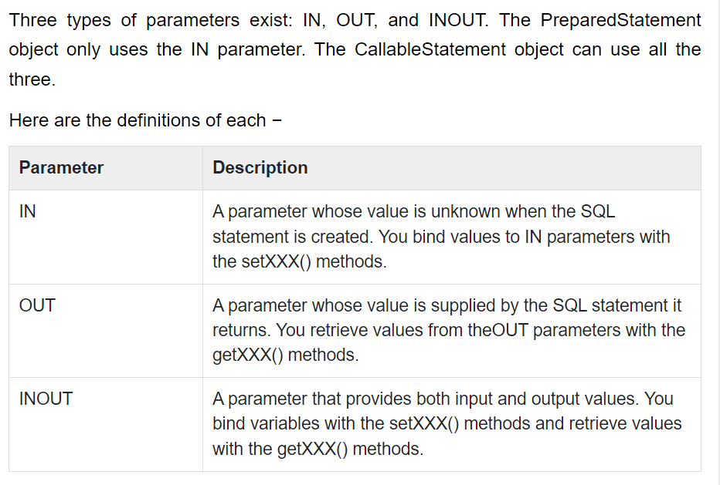

Slide 17
The following code snippet shows how to employ the Connection.prepareCall() method to instantiate a CallableStatement object based on the preceding stored procedure −
CallableStatement cstmt = null;
try {
String SQL = "{call getEmpName (?, ?)}";
cstmt = conn.prepareCall (SQL);
. . . }
catch (SQLException e) {
. . . }
finally {
. . . }
The String variable SQL, represents the stored procedure, with parameter placeholders.
Using the CallableStatement objects is much like using the PreparedStatement objects. You must bind values to all the parameters before executing the statement, or you will receive an SQLException.
If you have IN parameters, just follow the same rules and techniques that apply to a PreparedStatement object; use the setXXX() method that corresponds to the Java data type you are binding.
When you use OUT and INOUT parameters you must employ an additional CallableStatement method, registerOutParameter(). The registerOutParameter() method binds the JDBC data type, to the data type that the stored procedure is expected to return.
Once you call your stored procedure, you retrieve the value from the OUT parameter with the appropriate getXXX() method. This method casts the retrieved value of SQL type to a Java data type.

Slide 18
Closing CallableStatement Object
Just as you close other Statement object, for the same reason you should also close the CallableStatement object.
A simple call to the close() method will do the job. If you close the Connection object first, it will close the CallableStatement object as well. However, you should always explicitly close the CallableStatement object to ensure proper cleanup.
CallableStatement cstmt = null;
try {
String SQL = "{call getEmpName (?, ?)}";
cstmt = conn.prepareCall (SQL);
. . . }
catch (SQLException e) {
. . . }
finally {
cstmt.close(); }

Slide 19
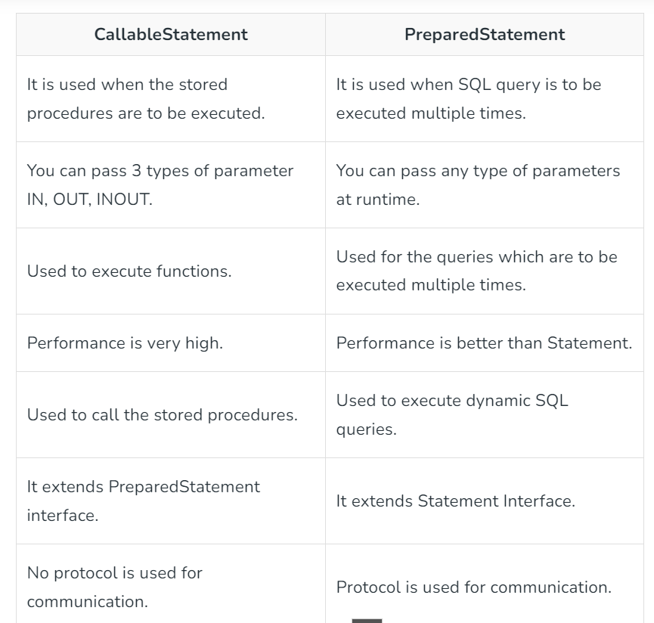

Slide 20
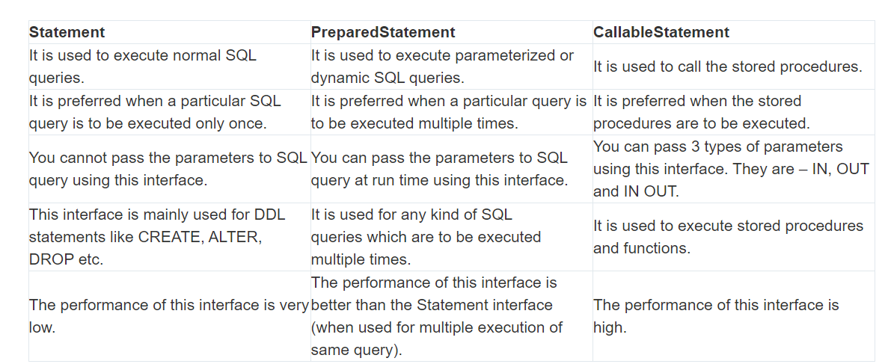

Slide 21
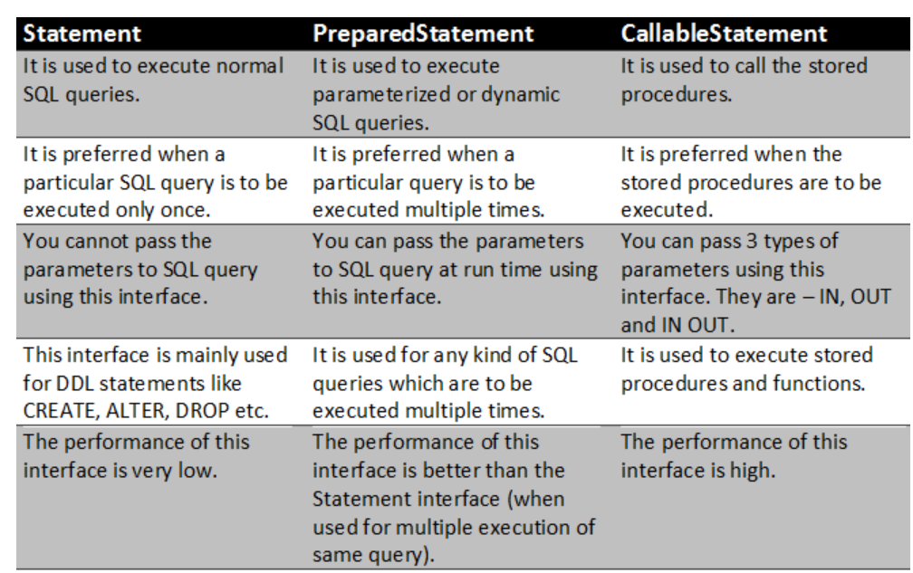

Slide 22
